Slide 1
Data Science Case Study: Recommendation Engine for Taxi Next Destination

Slide 2
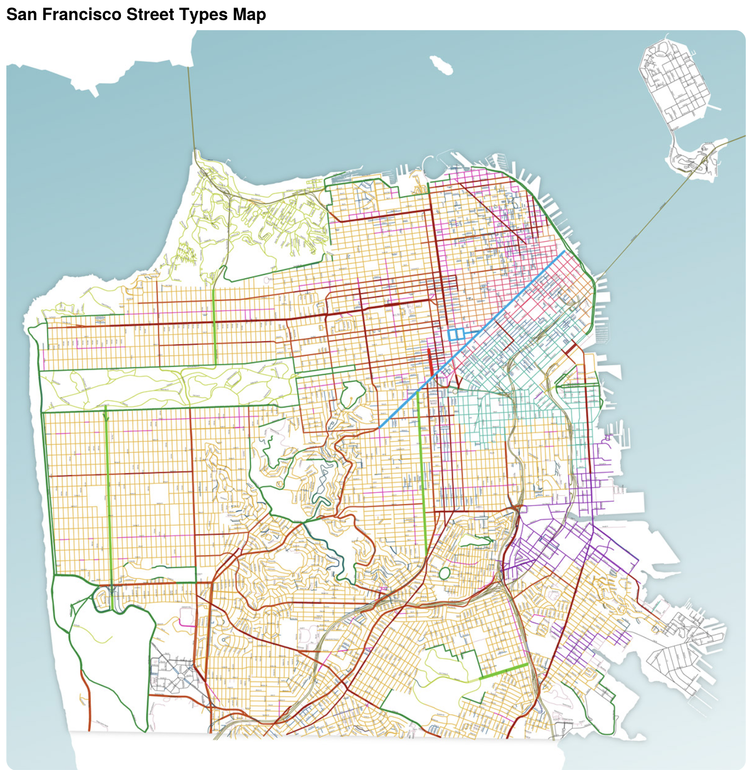
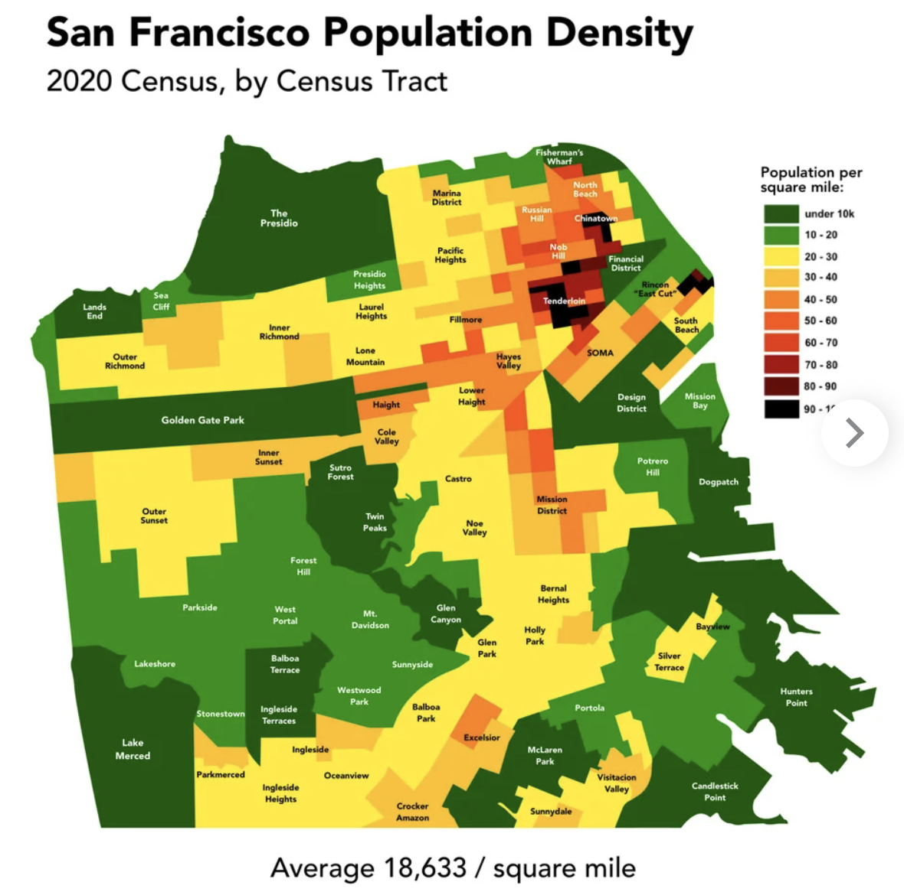
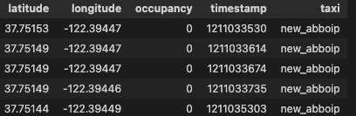
Background
With data on mobility traces of taxies (~500) in 30 days @ San Francisco
Q1: Calculate potential reduction of CO2 emissions in a year, when engine-powered vehicles will be replaced by electric vehicles at rate 15% per month
Q2: Build a predictor for taxi drivers, predicting the next place where a passenger will hail a cab
Data: https://github.com/PDXostc/rvi_big_data/blob/master/cabspottingdata.tar.gz

Slide 3
Q1: Potential Reduction of CO2 Emissions
Since the engine-powered vehicles will be replaced by electric vehicles at rate 15% per month, the month Co2 emission is a geometric sequence:
1, 0.85, 0.85^2, 0.85^3 …
Here “1” stands for the normalized amount of CO2 in the first month since taxi replacement starts (assumed to be the same as when all taxies are engine based, another hypothesis: each engine taxi exhausts the same amount of CO2 every month)
Therefore, in 12 months, the reduction rate of CO2 emission compared to the case before taxi replacement is
1-(1-0.85^12)/[(1-0.85)*12]=0.52
The total miles without passengers of all taxies in one month is 1263482 miles. Therefore, the total reduction potential of CO2 in one year is
1263482 mile*12*404 g/mile * 0.52= 3,206,430,468 g

Slide 4



Q2: Recommend Next Place to be Occupied
Two step solution to construct a recommendation engine:
Classification model on oppucation at a given next pace
Simulation on possible next destinations, and recommend the proming ones to drivers
Application scenario: when a taxi is dropped of (free)

Slide 5
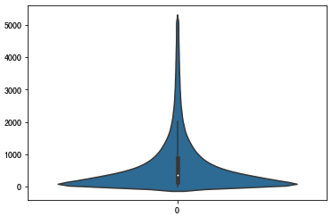
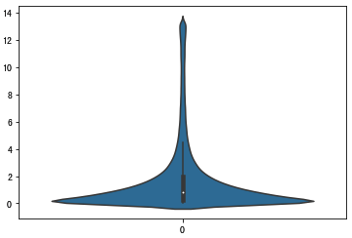
Drop-off -> Pick-up Session Data Construction
Session | Taxi | Timestamp | Position | Occupation
 | a |  |  | 1
1 | a | 1_t1 |  | 0
1 | a | 1_t2 |  | 0
1 | a | 1_t3 |  | 0
1 | a | 1_t4 |  | 1
 | a |  |  | 1
2 | a | 2_t1 |  | 0
2 | a | 2_t2 |  | 0
2 | a | 2_t3 |  | 1
 | a |  |  | 1
 | b |  |  | 1
 | b |  |  | 1
3 | b | 3_t1 |  | 0
3 | b | 3_t2 |  | 0
3 | b | 3_t3 |  | 1
 | b |  |  | 1
Distribution of session length in seconds
Distribution of session length in miles
Drop off
Pick up
Drop off
Each full session will be broken into rolling sub sessions depending on the steps in the sequential data E.g., 1_t1 : target_variable
1_t1 -> 1_t2 : target_variable
1_t1 -> 1_t2 -> 1_t3: target_variable 1_t1 -> 1_t2 -> 1_t3 -> 1_t4: target_variable
The mastar table will be generated based on the sub sessions data
Pick up
Drop off
Pick up

Slide 6
Feature Engineering and Target Variable Contruction
Feature Engineering
Taxi attributes: >Accumulated time since last drop-off >Accumulated moving duraiton since last drop-off >Direct distance from origin place of last drop-off >Speed >Current position >Current timestamp >Next position >Next timestamp
Traffic status: >Number of taxies in the city in past given time (e.g., past 1 minute) >Taxi occupation rate in the city in past given time >Number of taxies in the area surrounding the taxi in past given time >Taxi occupation rate in the area surrouding the taxi in past given time > + the above information in even earlier time (moving steps)
Target Variable Construction
Target: Occupation state at next position

Slide 7
Master Table Structure and Classification Model
We will build classification model based on the following data structure
Other Features | Next Position | Next Timestamp | Occupation at Next Position
This is to answer such question: Given current known information (Taxi/journey attributes and very recent traffic status), suppose the taxi is going to reach some destination as next step within a given time, what is the probility to get a passenger? * Next timestamp can be a fixed target time, e.g., typicially 1 minute, the average duration in the recorded data.

Slide 8
Typical Recommendation System
With prediction ability by machine learning model, recommendation engine can be buit based on simulation
Simulation
Unchangeable features
Controllable features
Next Position 1 | Next Timestamp 1
Occupation at Next Position 1
0.1
Other Features
Next Position 2 | Next Timestamp 2
Predict
Occupation at Next Position 2
0.4
Combine
…
…
Next Position n | Next Timestamp n
Occupation at Next Position n
0.9
Recommendation

Slide 9
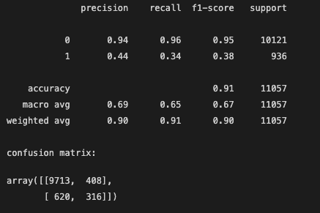
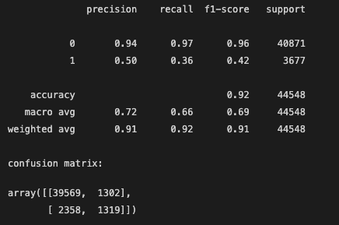
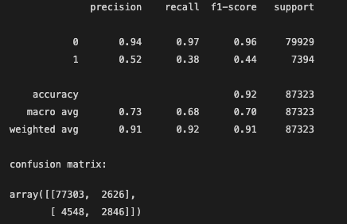
Model Performance – Evolution Along with Data Size Increase
Select Light GBM model out of [Light GBM, XGBoost, Random Forest] after comparison
4.3% sampling (Feature engineering: 36 min)
8.6% sampling (Feature engineering: 151 min)
17.2% sampling (Feature engineering: 300 min)
* Computation time is limited by the feature engineering on traffic status (surrouding occupation ratio in almost real-time for each Taxi)
* Not using complete data set but just sampled data, due to computaiton resource and time limitation. Even higher model performance is expected if leverating all dataset.

Slide 10
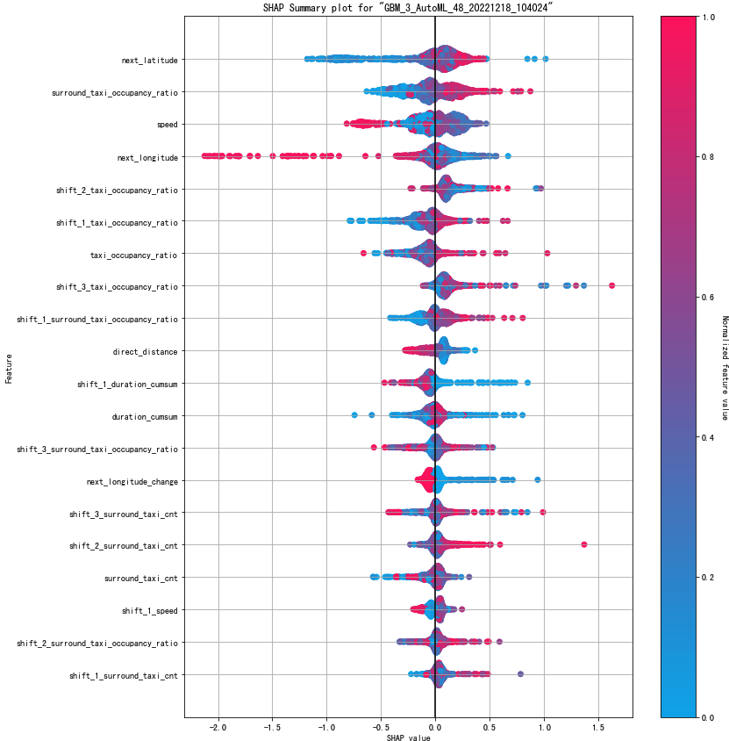
Feature Importance and Insight
Following factors can bring higher probility to get a passenger for a taxi roaming without a passenger:
Higher latitude (downdown with higher population density)
Higher taxi occupancy ratio (high demand on taxi usage)
Lower speed (easier to notice a passenger or the road is not high-speed trunk road)
Less accumulated distance/duration since last drop off (the longer of this metric, means the more difficult to get a passenger in the past – also less probability in next place)

Slide 11

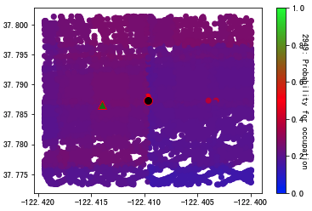
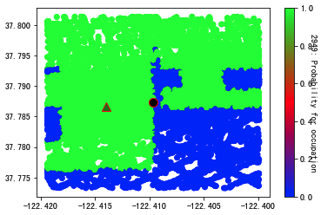
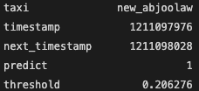

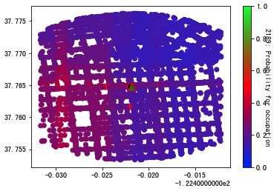
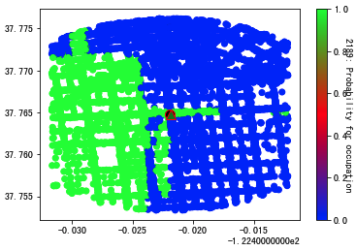
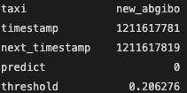
Recommendation Application & Verification
Correct Prediction
Current
Next (Pick up in actual)
Wrong Prediction (nearly correct)
Possible movement range in a given duration (e.g., 1 minute) – simulation space
Limited by:
Speed
Road availability

Slide 12
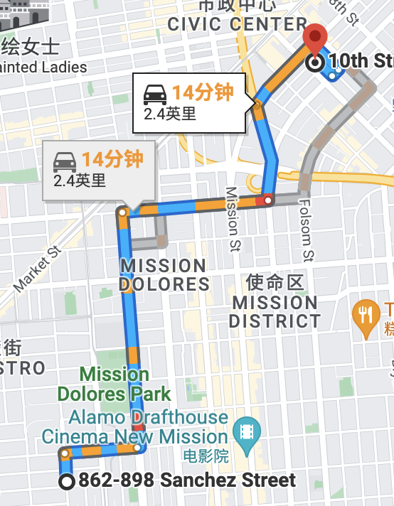
How Street Map Can be Outlined

Slide 13

Thank You!
Q & A

